Slide 1
Empowering Early Detection of Heart Attack Risks with Machine Learning
Team 1 | Mentor: Mr. Ankush Bansal | Batch: PGP-DSE June’24
Team Members:
Aarti Gupta , Baljit Singh Karnavat , Nikhil Vinod,
Raghavendra S , Shashwat Girish Irny , Vergin J

Slide 2


Problem Definition
Problem Definition, Technology and Business Problem:
Heart disease is a global health concern due to high mortality rates from late detection.
Why It’s Important:
Early prediction can save lives and reduce healthcare costs.
Value Additions Planned:
Build a machine-learning model to predict heart attack risk.
Enable early medical intervention and personalized treatment.

Slide 3
Suggested Solution and EDA
Suggested Solution:
Use machine learning models to predict heart attack likelihood using health records.
Data Sets Considered :
Source –Kaggle
Pytlak, K. (2021). Personal Key Indicators of Heart Disease [Dataset]. Kaggle. Retrieved from
Link -https://www.kaggle.com/datasets/kamilpytlak/personal-key-indicators-of-heart-disease
There are total 40 Columns and 445132 Records.
In which 6 numeric columns and 34 categorical columns.
There are 157 Duplicate rows in this dataset
There are missing values in the dataset.
'HadHeartAttack' is the Target variable here.

Slide 4
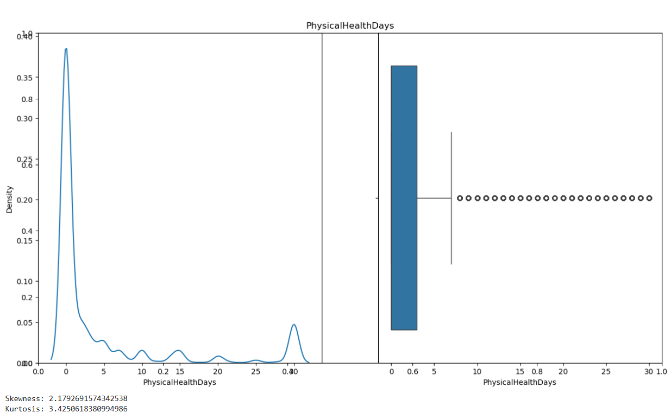
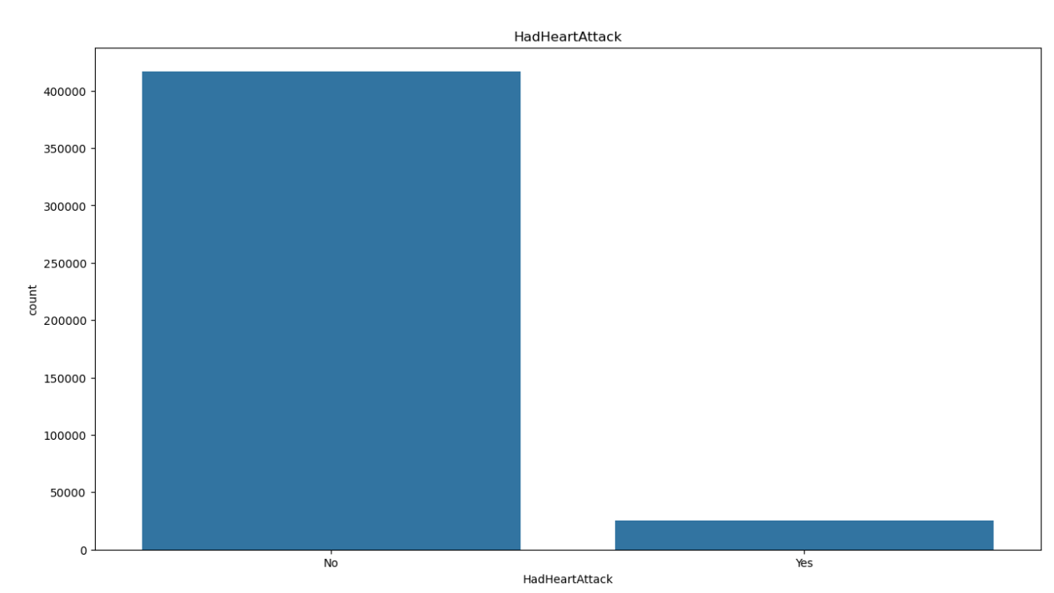
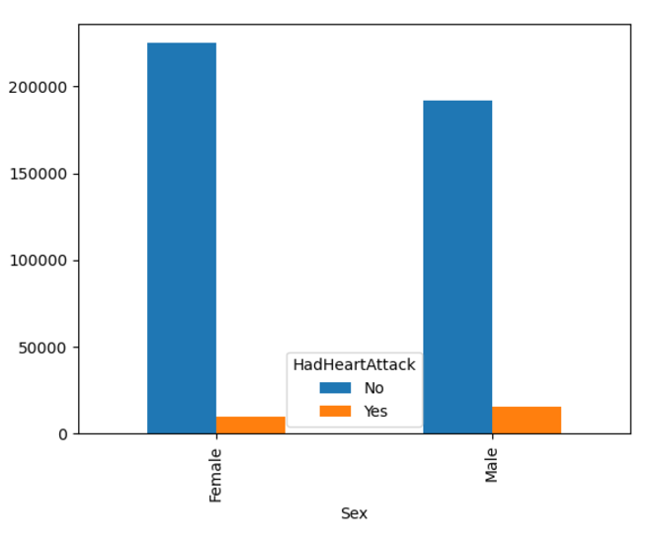
Exploratory Data Analytics (EDA):
Data Visualization
Univariate analysis
Numeric Variables (Fig 1)
All the Numeric Columns except(Height column-normal skew) are rightly skewed,
Outliers are present in all the numeric columns
Categorical Variables (Fig 2)
Count plot- for frequency to visualize subcategories inside categorical attributes.
Key Inferences from categorical columns –Majority of
Gender is Female .
Age category in between 65-69 years.
Alcohol drinkers
Race: Predominantly observed White race.
Ethnicity are Non-Hispanic.
Bivariate analysis (Fig 3)
Imbalance data as well in the target variable.
Fig 1
Fig 2->
Fig 3->

Slide 5
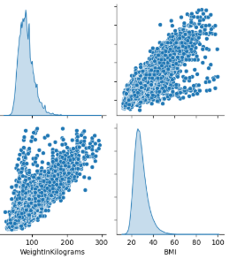
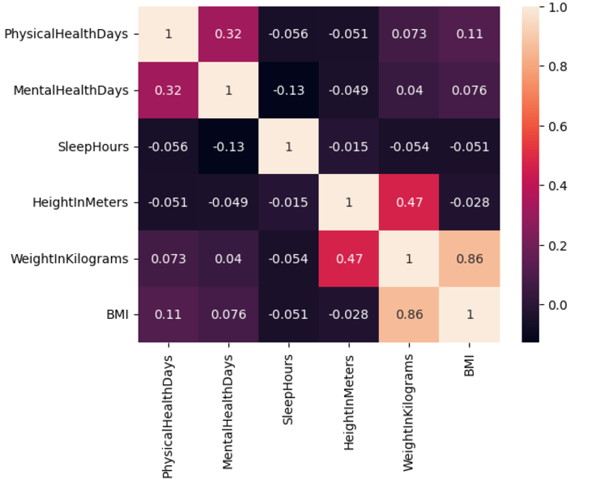
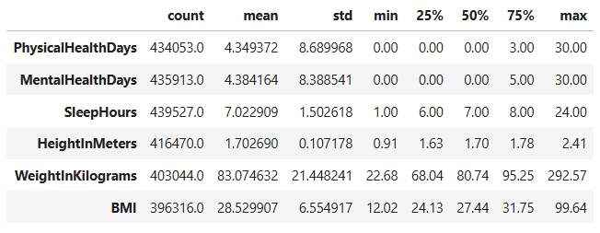
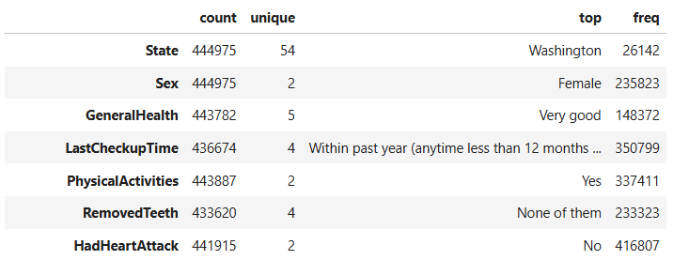
For Numeric Columns
Multivariate Analysis
Heatmaps & Pair plot- : For relationships between variables.(Fig 4 & Fig 5)
There is a correlation b/w Weight in Kilograms and BMI.
It is a positive trend that we can see from the visualization.
Fig 4
Fig 5
Data Summary
For Categorical Columns

Slide 6
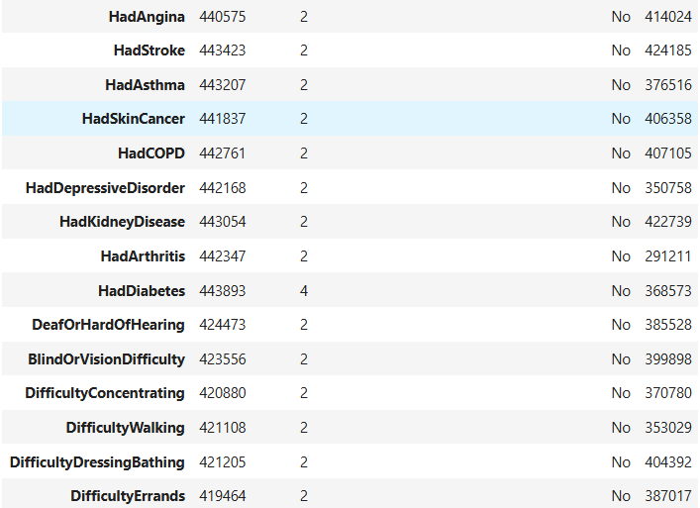
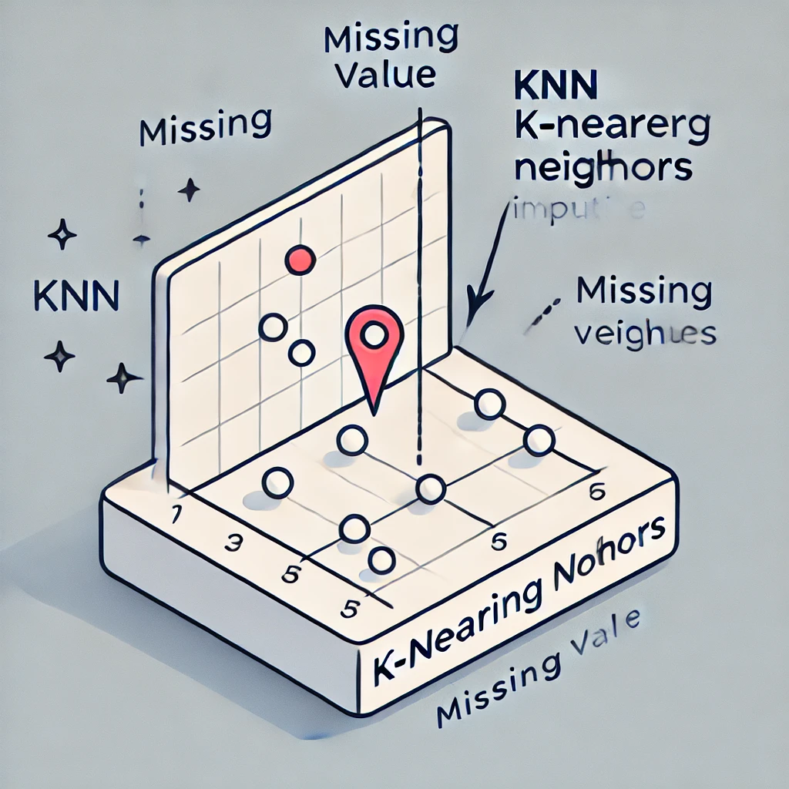
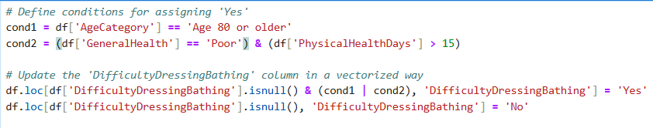
Exploratory Data Analytics (EDA)
Data Summary
For Categorical Columns- Imbalance in the data.
That is there are more records of subcategory 'No' than 'Yes' in the columns.
Data cleaning
Missing Value Treatment – KNN Imputation for numerical variables (except BMI)
For BMI Imputation using by formula. (Weight(kg)/Height(m)**2)
Missing Value Treatment -Logical imputation and mode imputation for categorical variables.

Slide 7

Exploratory Data Analytics (EDA)
Data cleaning
Logical Imputation Examples
RaceEthnicityCategory :
States with a higher population of a particular race or ethnicity have been imputed accordingly.
PhysicalActivities:
Imputing physical activities with No when the patient has arthritis, difficulty in dressing , bathing and walking.
FluVaxLast12:
Imputing Fulvax last 12 with Yes when the patient age is 65-69 or older(assuming all the older peoples are vaccine)
Dropping the rows which have missing values in more than 10 columns
Not considering the rows which has null values in the target columns
Duplicate Removal – Removing 157 Duplicate rows in this dataset .

Slide 8
Feature Engineering
In Columns: LastCheckupTime, HadDiabetes, CovidPos, RaceEthnicityCategory, State, AgeCategory.
New Feature Creation: Separating Race and Ethinicity from RaceEthinicityCategory column, created new feature called Region by grouping the states according to the regions.
Encoding
Label Encoding all the variables that has exactly two categories
Ordinal Encoding General Health & LastCheckupTime.(Because there is a Heirarchy)
Dummy encoding for other columns and dropping the first column.
Data Sampling:
Separating dataset into Features & Target and saving it into X and Y variables respectively.
Checking for multi-collinearity
Spliting the X and Y to train and test with (70:30 ratio)
Scaling the Train and Test data by Standard Scaler.

Slide 9
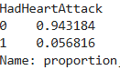
Challenges Expected/Addressed:
Missing data
Imbalanced data - Under Sampling or Class Weights
Model interpretability
Algorithms, Solution and Conclusions
Algorithms Considered:
Base model - Logistic Regression
KNN Classifier ,Naïve Bayes Classifier ,Decision Tree Classifier, Random Forest, Ada Boost ,
Gradient Boosting and XG Boost.
Solution Architecture:
Data Pipeline: Data collection → Preprocessing → Model Training → Evaluation.
Results:
Accurate prediction metrics like Recall and Accuracy .

Slide 10
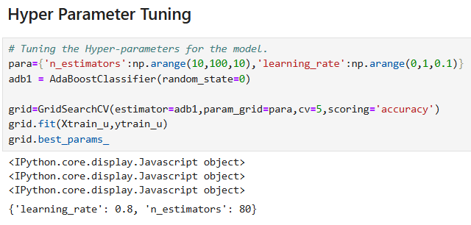
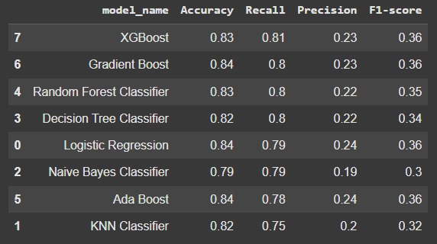
Model Tuning
Optimized Model Performance: Conducted hyperparameter tuning for all models using technique like grid search ., enhancing accuracy, precision, and recall metrics.
Fine-Tuning Strategies: Adjusted key parameters (e.g., learning rate, tree depth, samples split) to achieve optimal trade-offs between model complexity and performance.
Results of Algorithms Considered

Slide 11
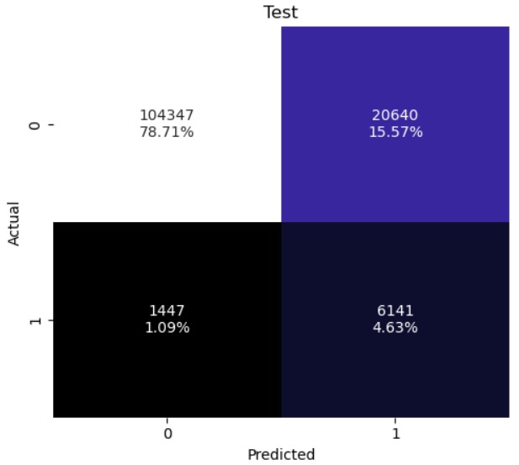
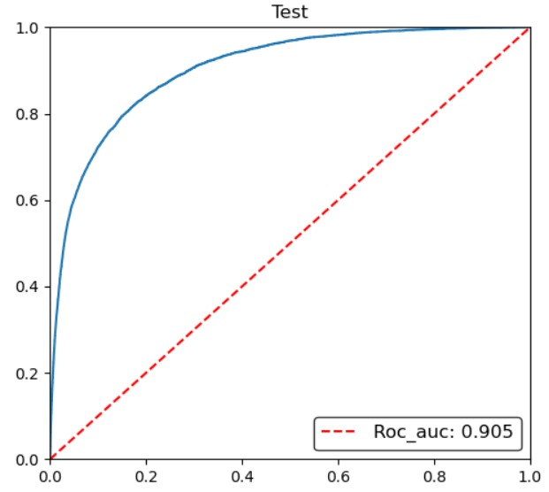
Problem Definition: Heart disease, a leading cause of mortality worldwide, underscores the urgent need for early detection to prevent late-stage complications and reduce death rates.
Business Impact: The XG Boost Classifier achieved the best accuracy and recall, enabling reliable early prediction of heart disease, improving patient outcomes, and reducing healthcare costs.
Confusion Matrix for XG Boost Classifier ROC-Curve (XG Boost Classifier)

Slide 12
THANK YOU

